Slide 1
LPP USING VARIOUS SOFTWARE

Slide 2
SOLVING LPP
USING EXCEL
Using Solver
USING R
Using”lpSolve”
Using Graph

Slide 3
USING EXCEL SOLVER
Activate Solver
In The Excel Open Add-Ins
Ensure Solver Add-in is Checked and proceed .
Open Solver
In The DATA Ribbon Find Analysis Group
Click on the icon representing Solver.
Enter The Objective
Enter Objective ,Add-> Subject to Constraints
Select Solving Method: ie Simplex LP and click SOLVE

Slide 4
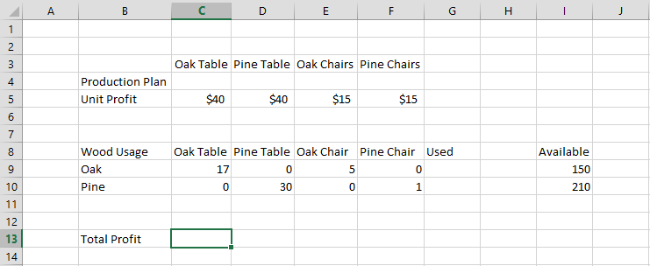

Slide 5
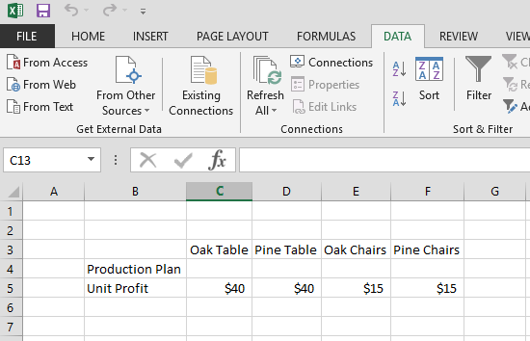

Slide 6
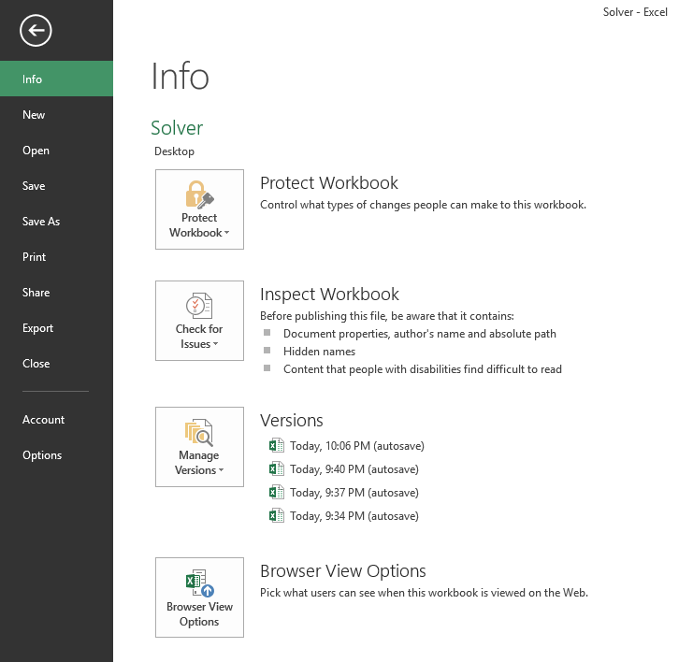
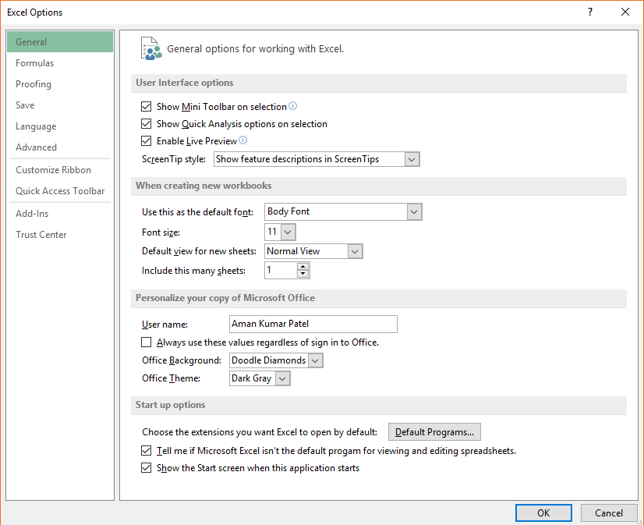
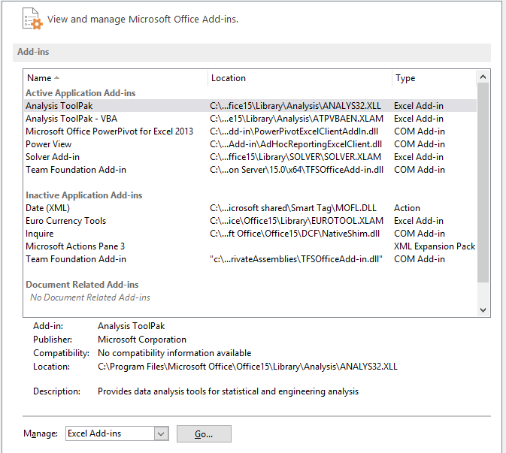
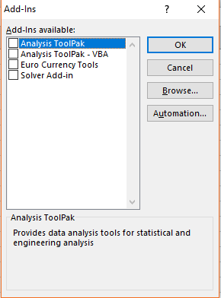

Slide 7
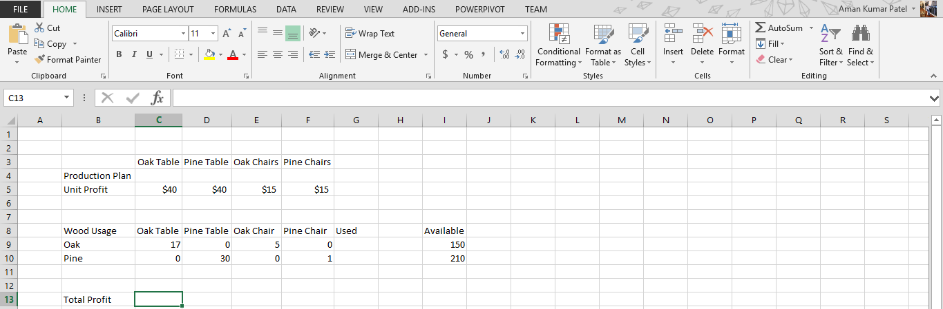
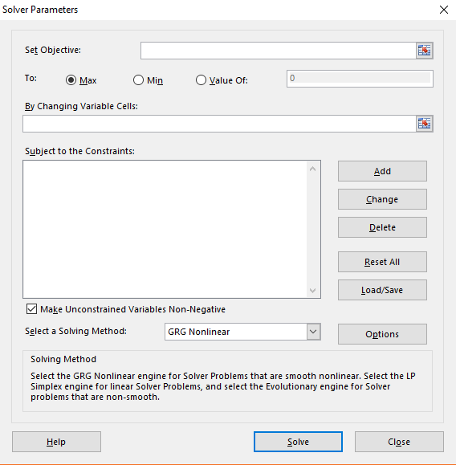

Slide 8
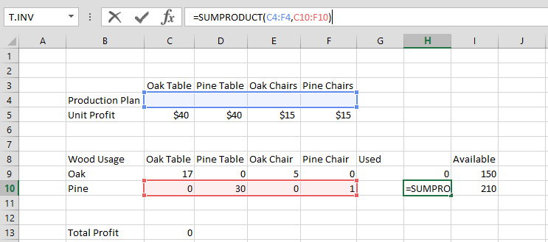
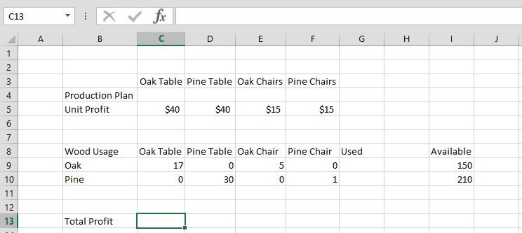
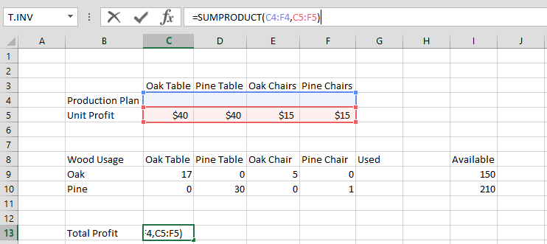
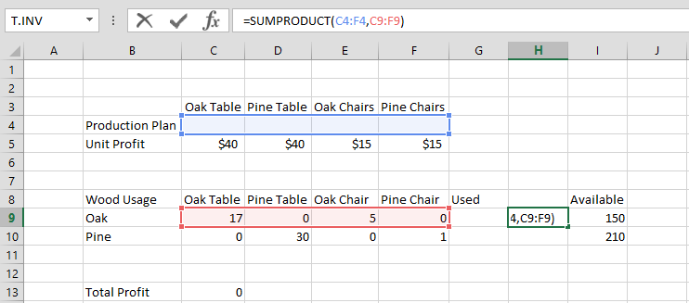
X1
X2
X3
X4

Slide 9
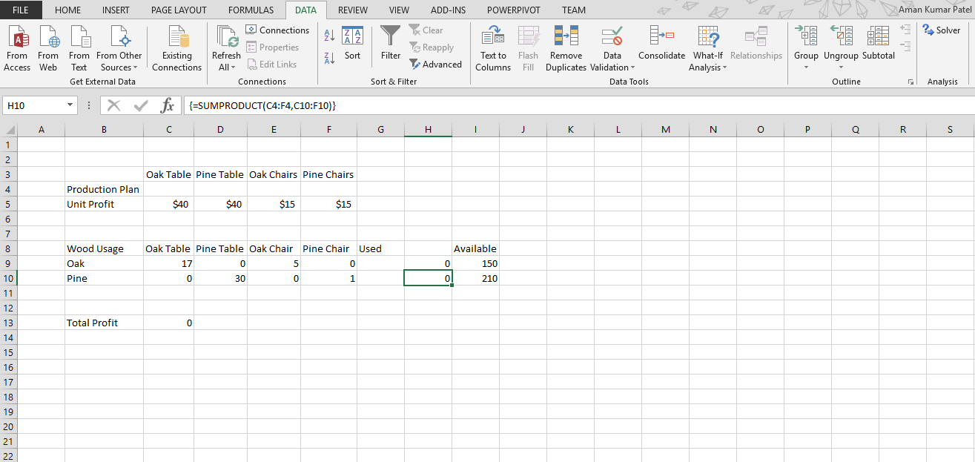
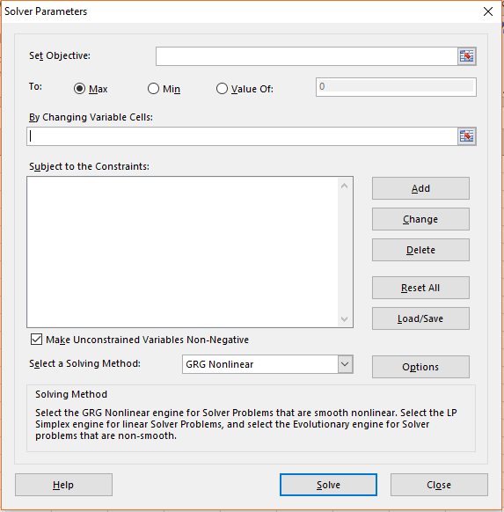
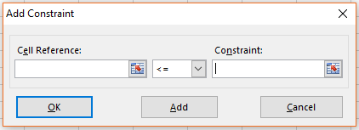
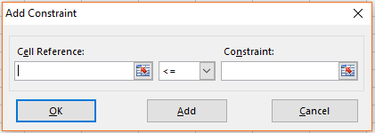

Slide 10
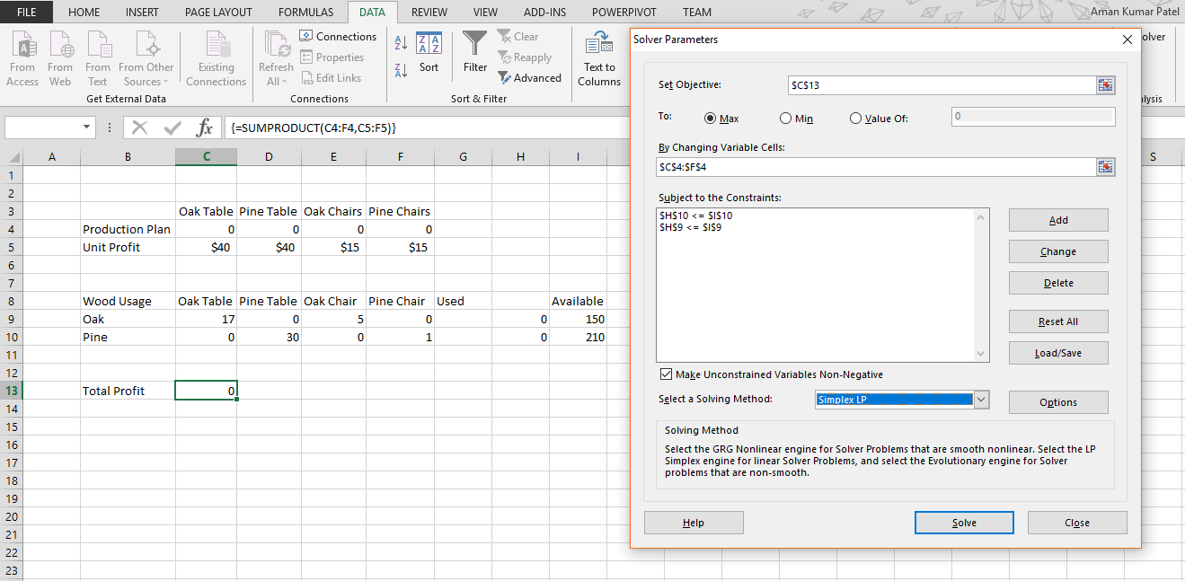

Slide 11
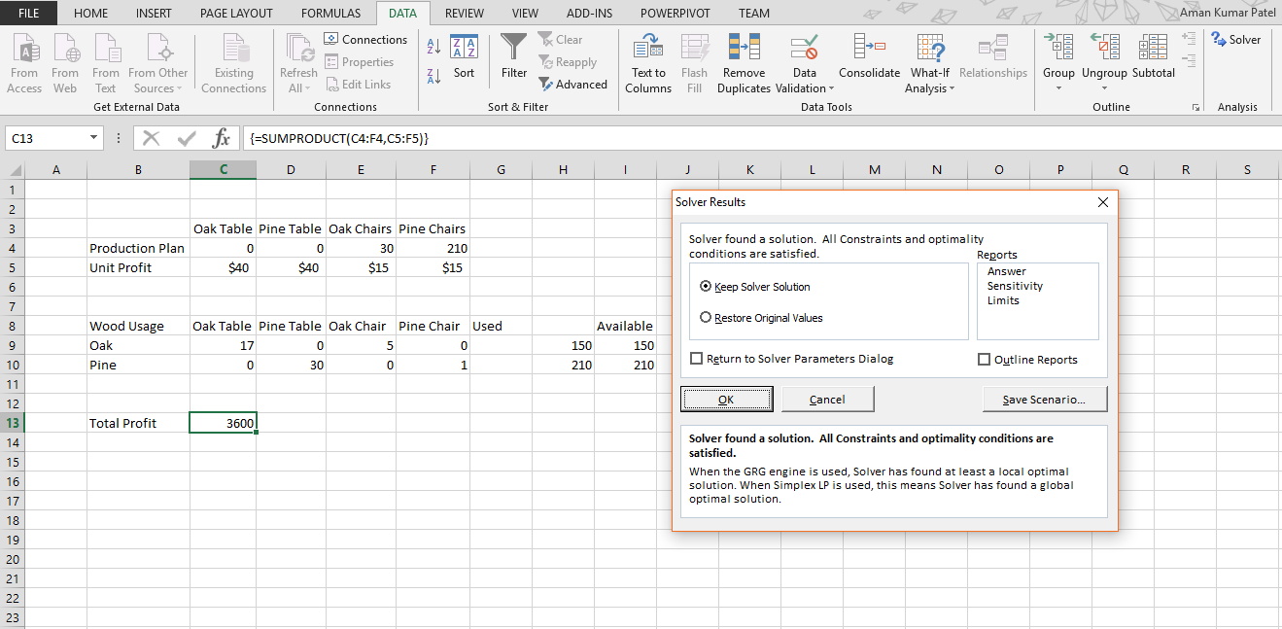

Slide 12
USING EXCEL GRAPH
Objective
We Need To write the Objective, Subjective in a certain Format (Appear In The Next Page)
Equation For The Graph
If X=0 Y=?
What ever necessary(Create a Table)
Inserting Lines
Insert->Charts->Scatter Diagram
Select (Select Data) to Add more lines to your graph and modify it
Showing Feasible Region
Insert->Shapes->Freeform
Finding Out (x,y)
&Y=0 X=?
X=1 Y=?
Using Matrix Formula MMULT and MINVERSE We can find out X1 and X2(Without Measuring the Graph)
Then Value of Z for each points, (whether Maximum or Minimum )

Slide 13
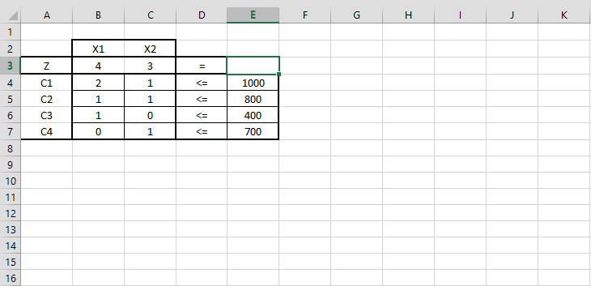
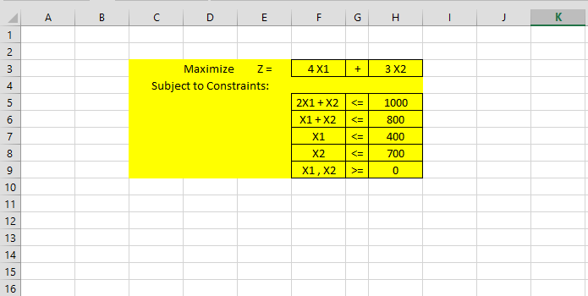

Slide 14
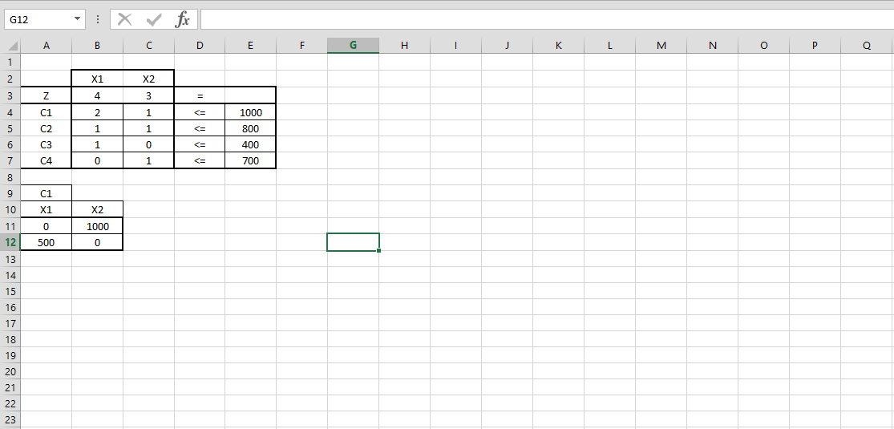
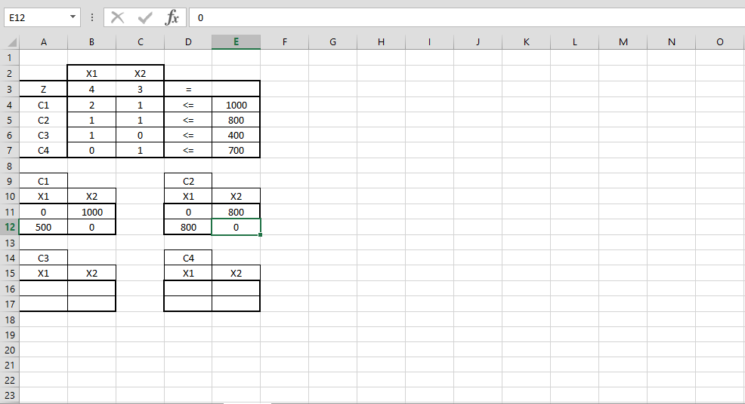



Slide 15
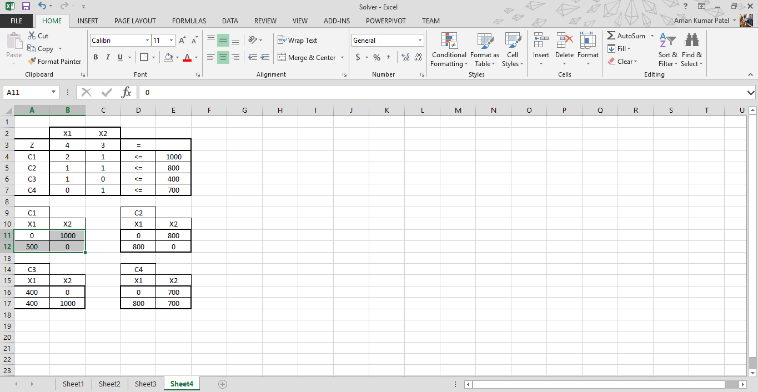
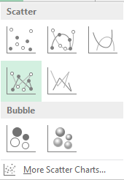

Slide 16
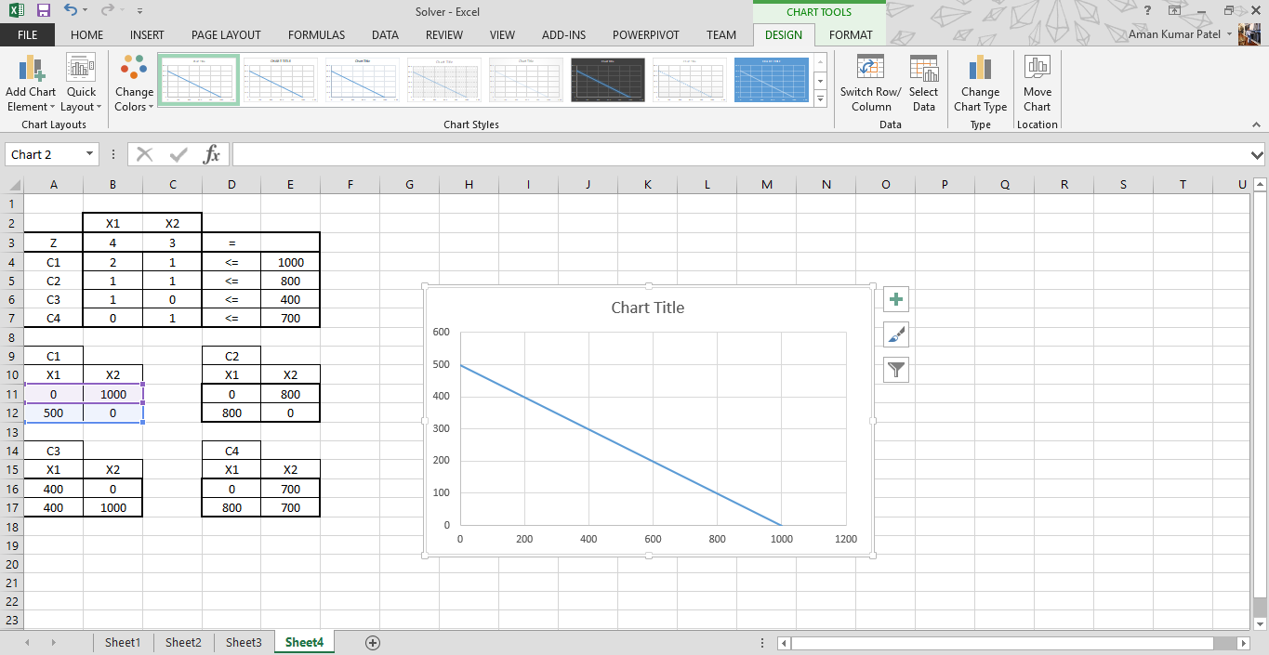
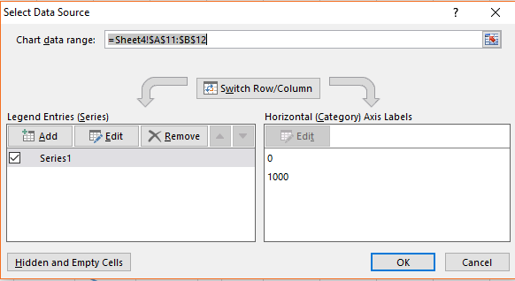
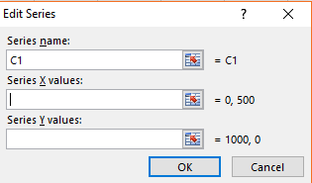

Slide 17
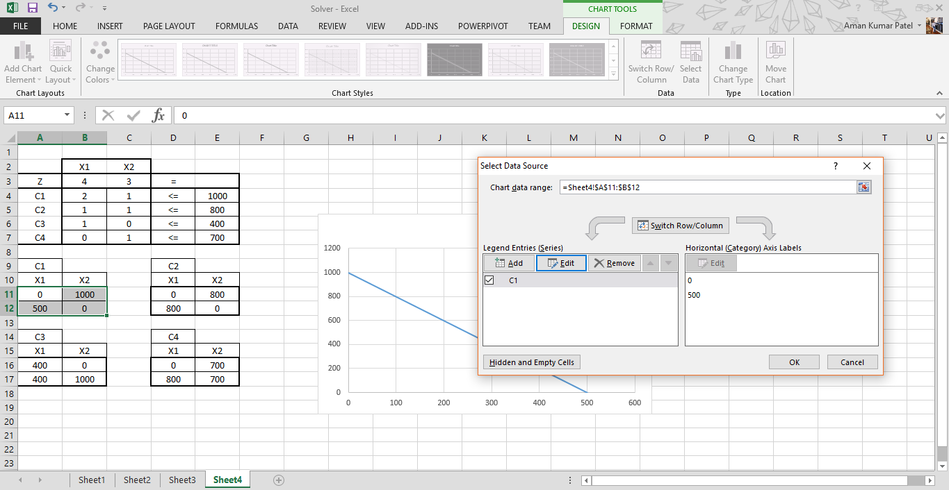

Slide 18
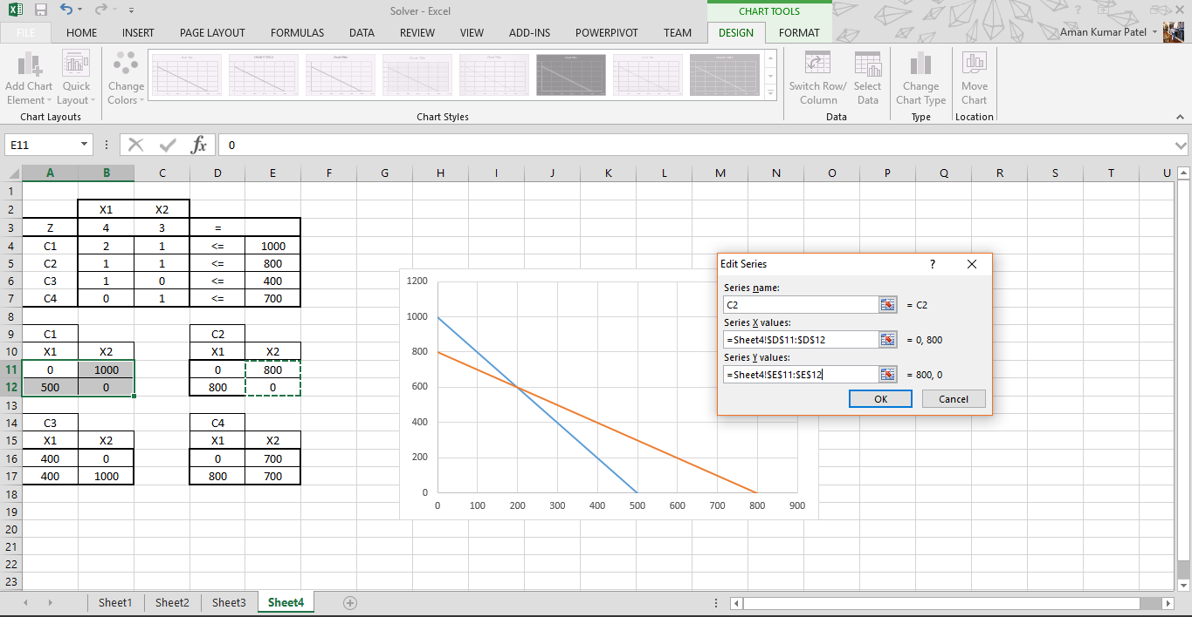
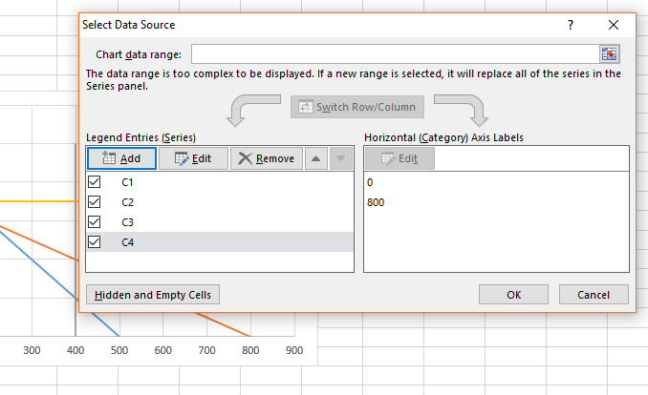
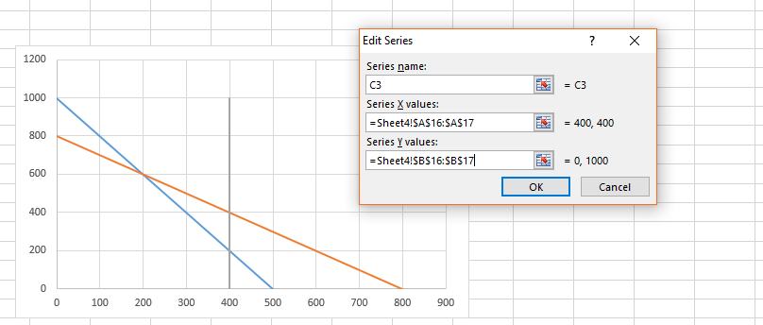
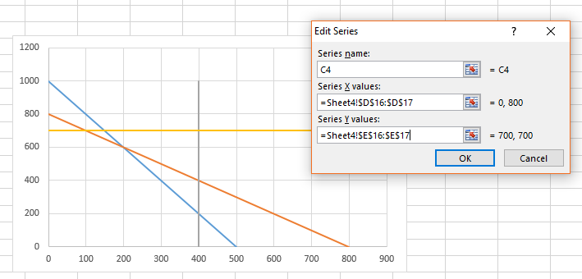

Slide 19
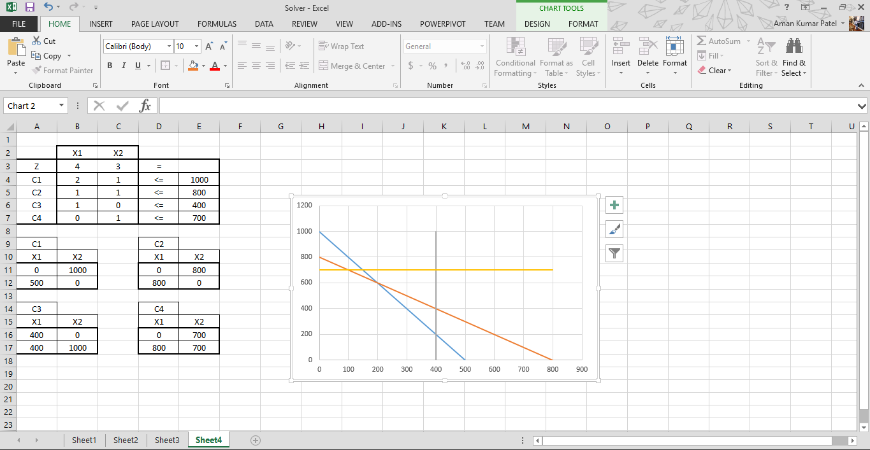
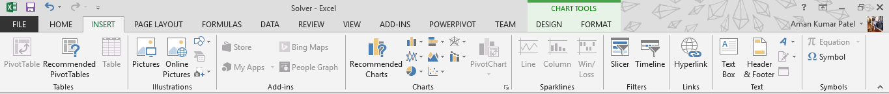
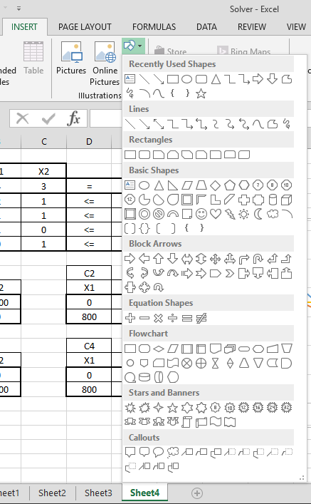


Slide 20
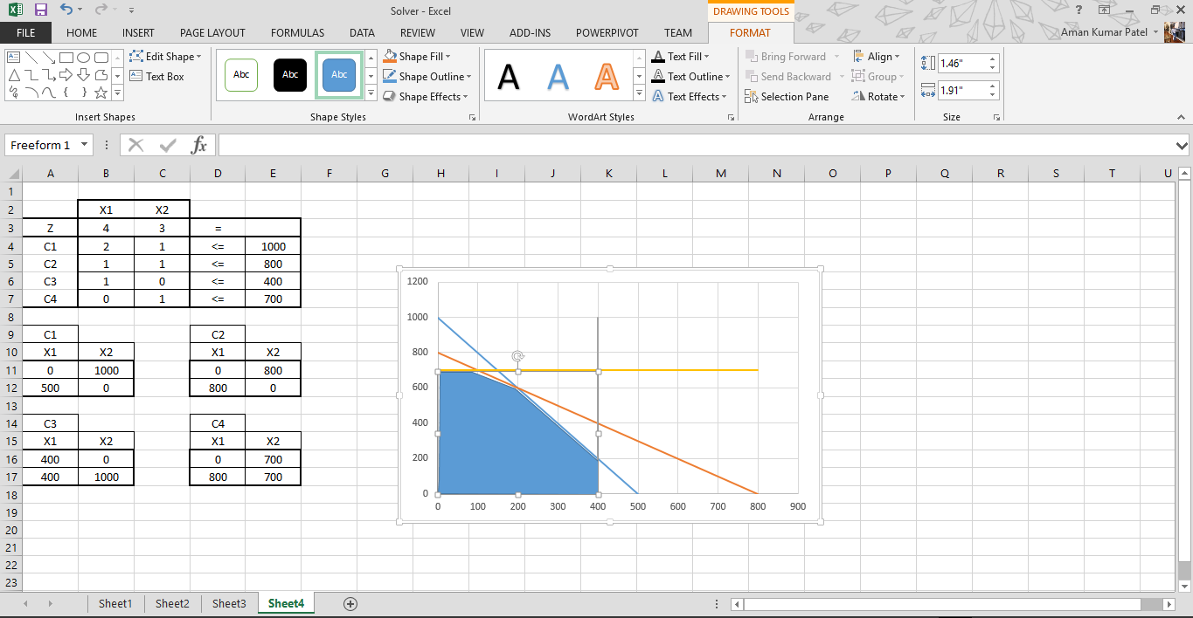

Slide 21
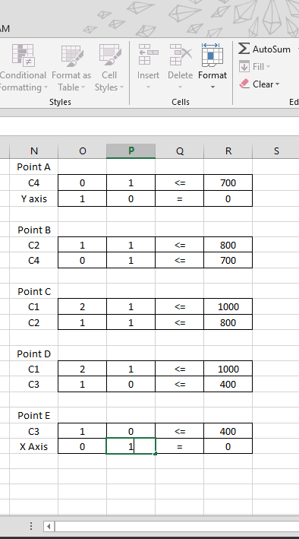
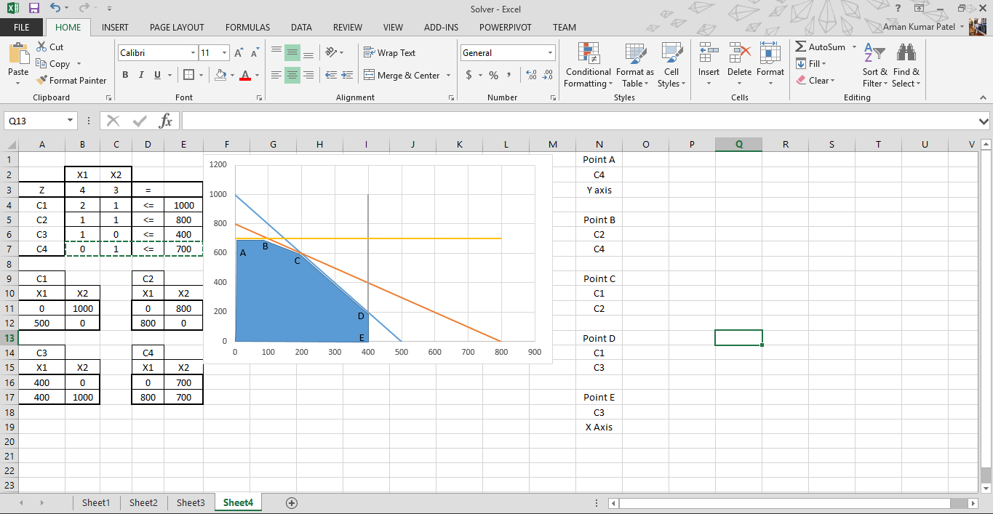
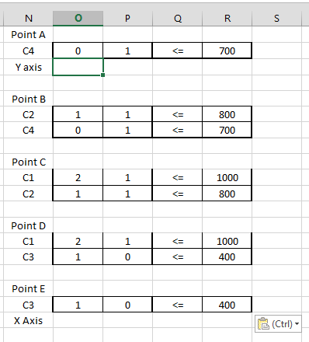

Slide 22
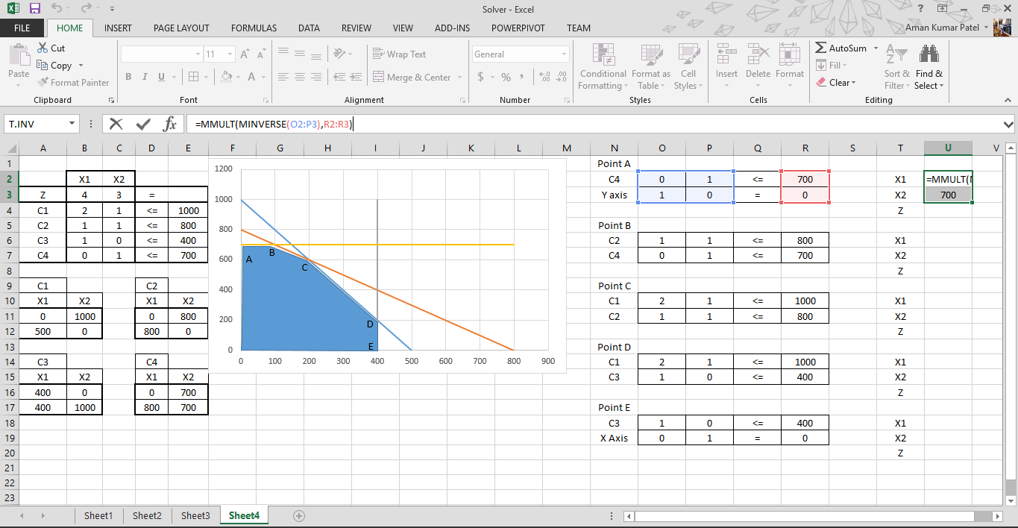
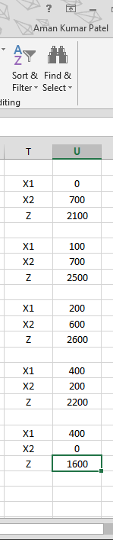
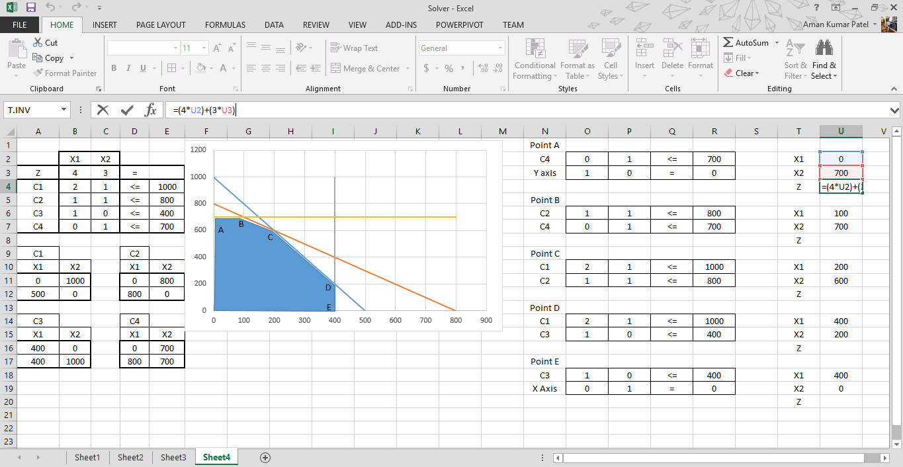
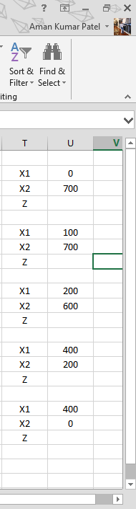

=(4 x X1 + 3 x X2)
=MMULT(MINVERSE(arrray 2X2),array 2X1)

Slide 23
Transportation problem :
Row/Column Minimal
North West Corner
Vogel Approximation

Slide 25
1X3
156
6X8
9X9
14X1
1X2
4X2
ROW MINIMAL

Slide 26
6X6
8X4
2X9
14X2
1X6
4X2
128
NORTH WEST CORNER

Slide 27
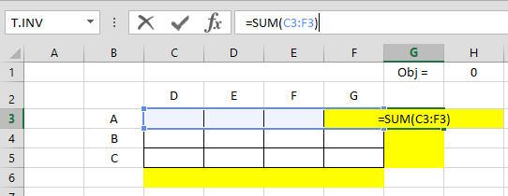
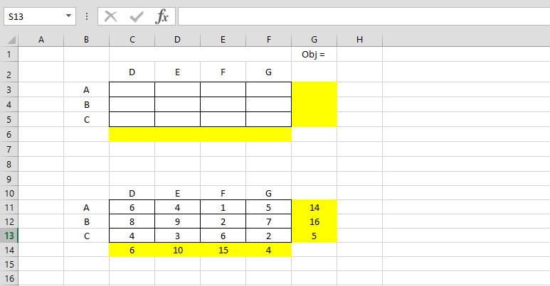
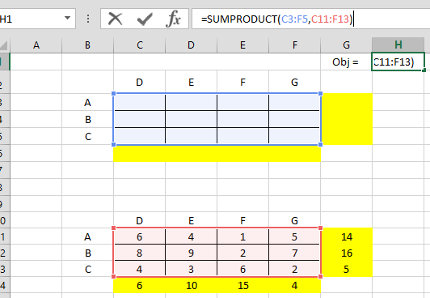

Slide 28
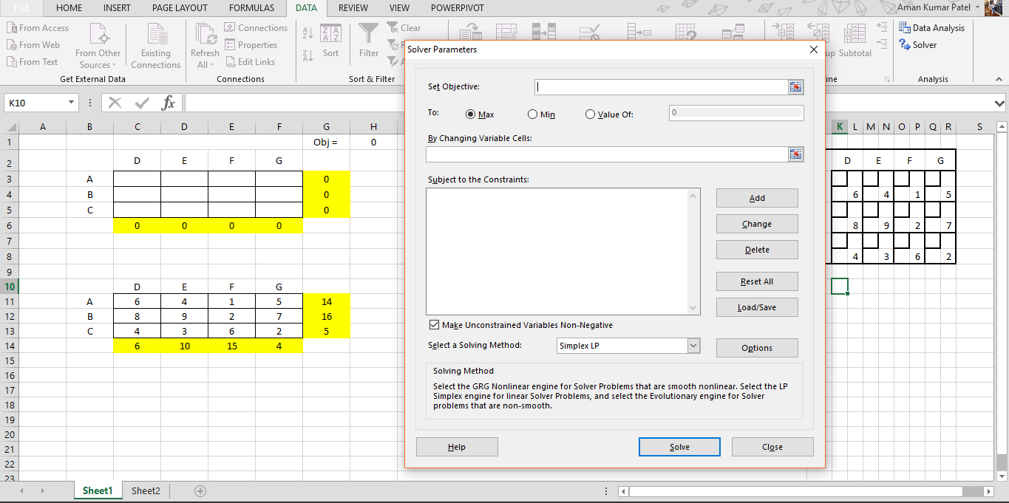



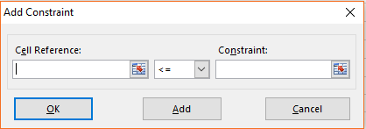


Slide 29
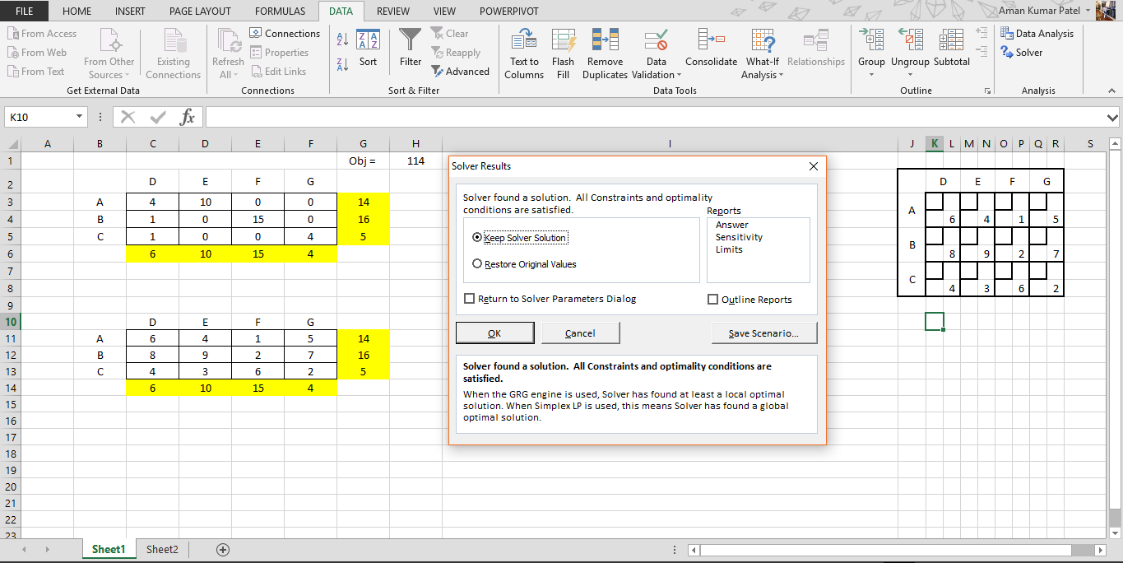
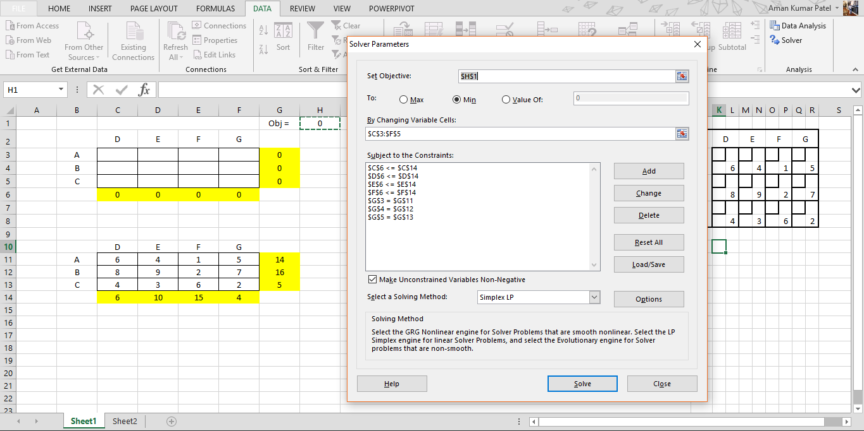


Slide 30
1x4
1x8
4x6
10x4
15x2
4x2
114

Slide 31
USING R PROGRAMMING
lpSolve
direction
objective.in
Solution
const.mat
const.dir
const.rhs

Slide 32
Install Package “lpSolver”
Objective Function
Constraints
install.packages("lpSolve")
Open Library
library(lpSolve)
obj.fun <- c(…………)
constr <- matrix(c(……….),ncol = …,byrow = TRUE)
Constraints’ Direction
RHS Value
constr.dir <- c("<=","<=",">=“…….)
rhs <- c(……..)
Solve
prod.sol <- lp(direction = "min",objective.in = obj.fun,constr,constr.dir,rhs,compute.sens = TRUE)

Slide 33
Transportation Problem
obj_fun <- c(6,4,1,5,8,9,2,7,4,3,6,2)
m<-3
n<-4
t_constr<- matrix(0, n+m ,n*m ) for (i in 1:m) {for (j in 1:n) { t_constr[i,n*(i-1) + j]<-1 t_constr[m+j,n*(i-1) + j]<-1 }}
constr_dir<-c("=","=","=","<=","<=","<=","<=")
rhs <- c(14,16,5,6,10,15,4)
prod.tra <- lp(direction = "min",objective.in = obj_fun,const.mat = t_constr,const.dir = constr_dir, const.rhs = rhs,compute.sens = TRUE)
prod.tra$objval
sol <- matrix(prod.tra$solution,m,n,byrow = T)

